Slide 1
Staunton District’s Experience with
Fiber Reinforced Polymer Systems

Slide 2
Fiber Reinforced Polymer Systems
Prices are for FRP only and do not include other costs associated with these repairs such as mobilization, traffic control, epoxy pressure injection of cracks, reinforcing steel, jacking and blocking, field welding, formed and poured concrete, gunite, waterproofing, etc.
Staunton District approach has been to first re-establish structural integrity with conventional means and then wrap the repair with FRP as added protection for when the member gets hit again. In other words, the classic belt and suspenders approach. We have not used FRP to independently reestablish or increase structural capacity.

Slide 3
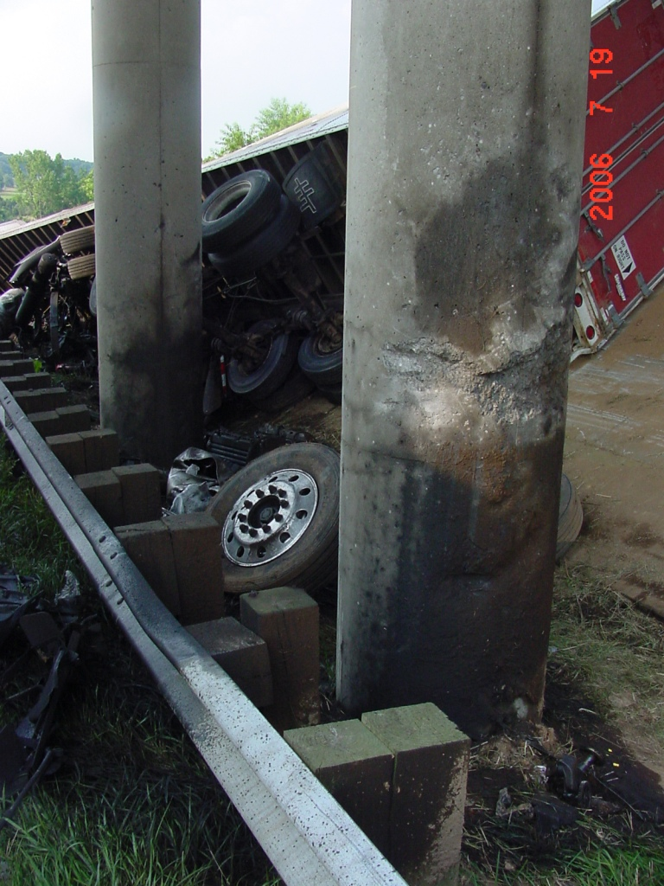
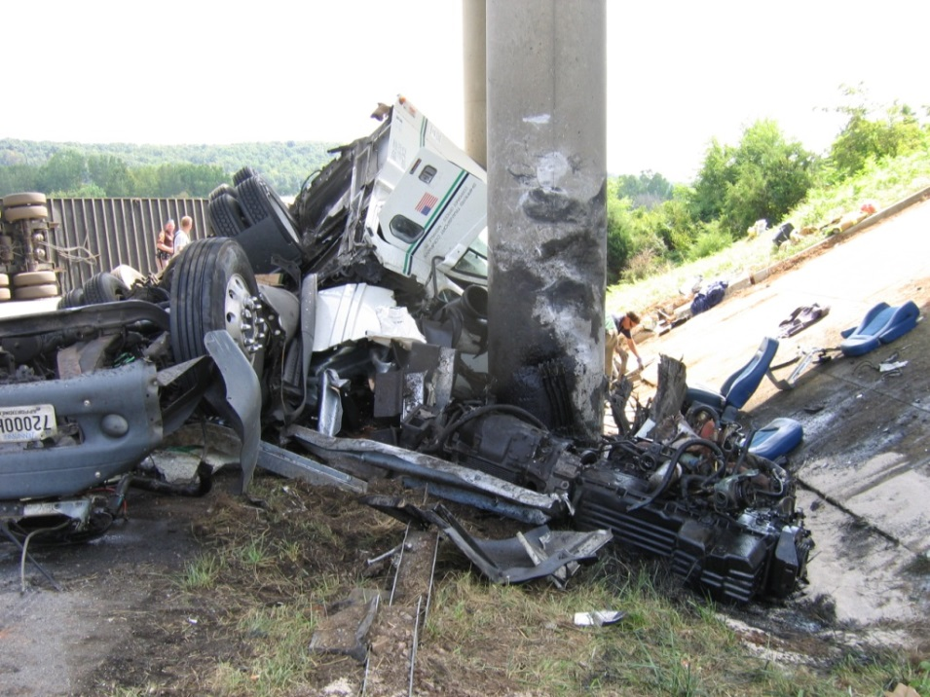
Route 994 over I-81 in Augusta County (VA Structure No. 6690)
September 2006
July 2006

Slide 4
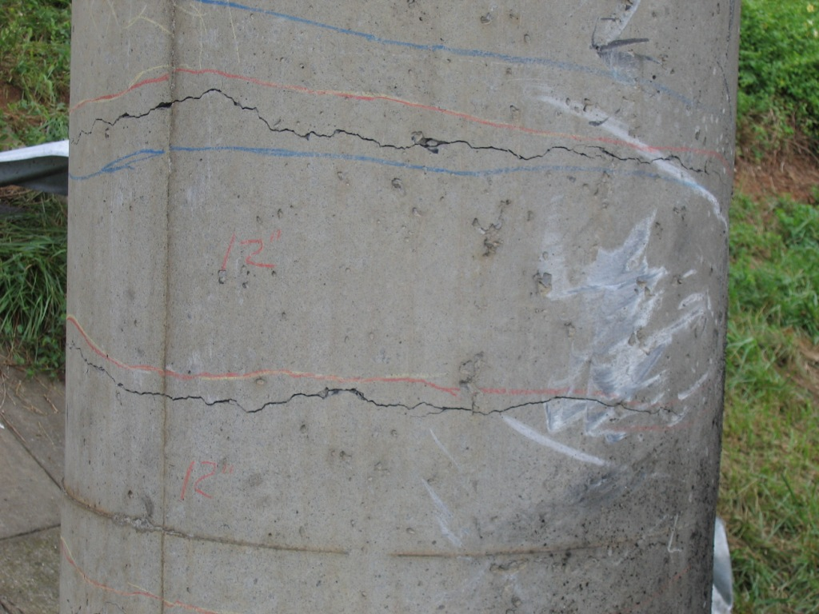
Route 994 over I-81 in Augusta County (VA Structure No. 6690)

Slide 5
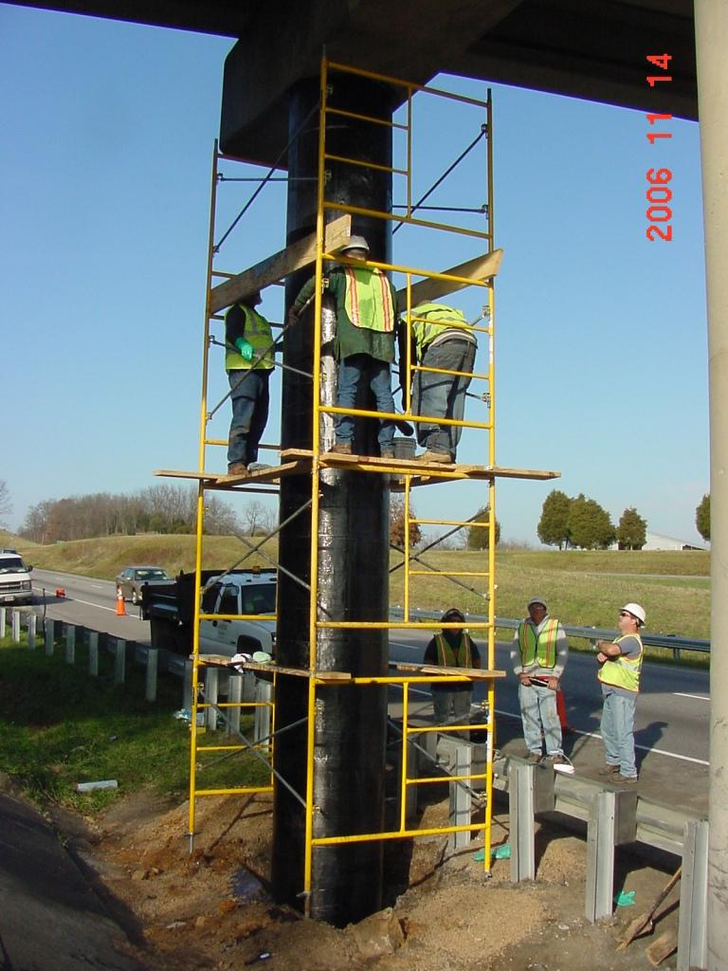
Route 994 over I-81 in Augusta County (VA Structure No. 6690)

Slide 6
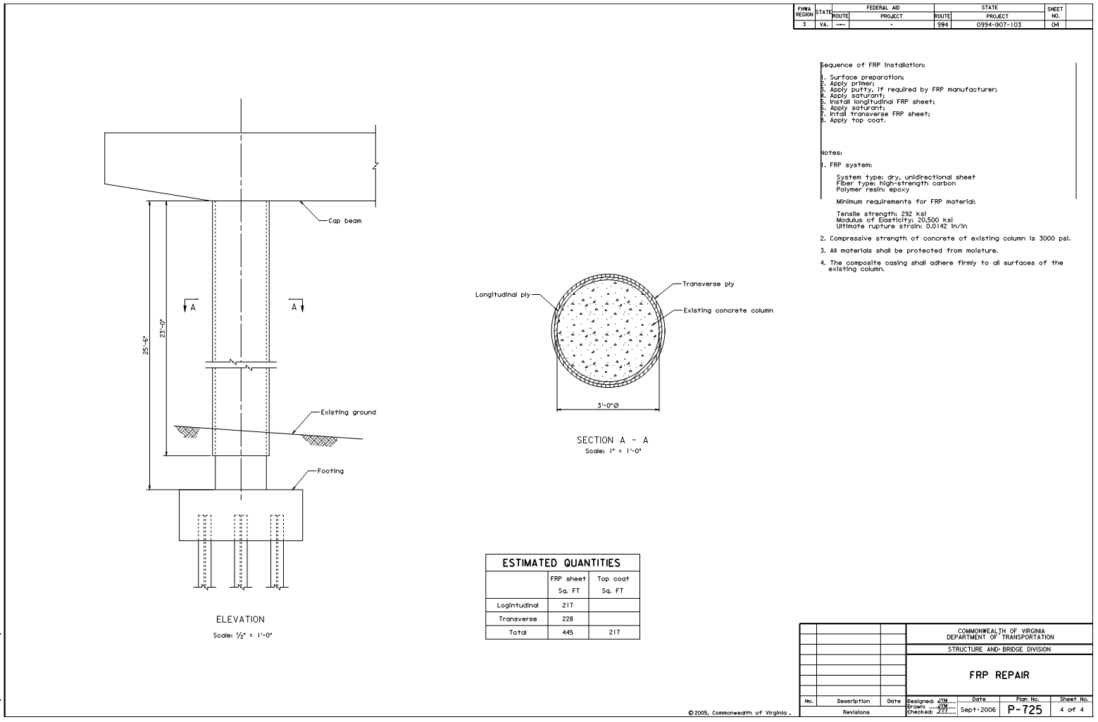
Route 994 over I-81 in Augusta County (VA Structure No. 6690)

Slide 7
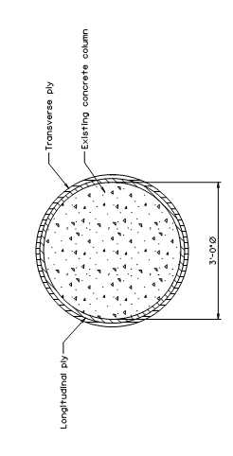
Route 994 over I-81 in Augusta County (VA Structure No. 6690)

Slide 8
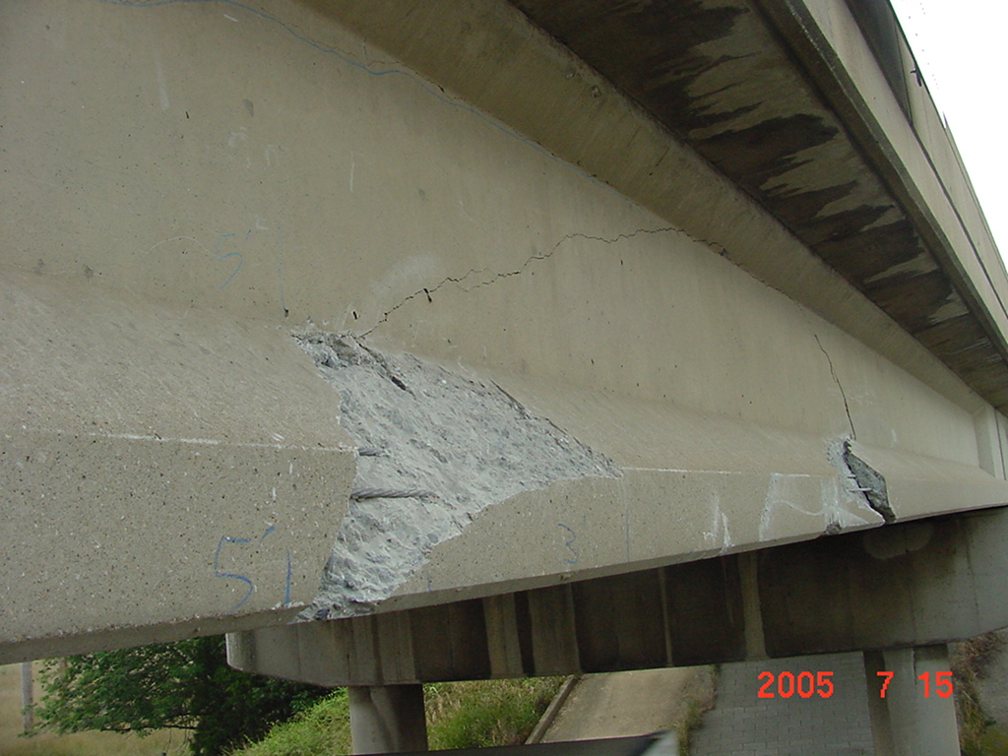
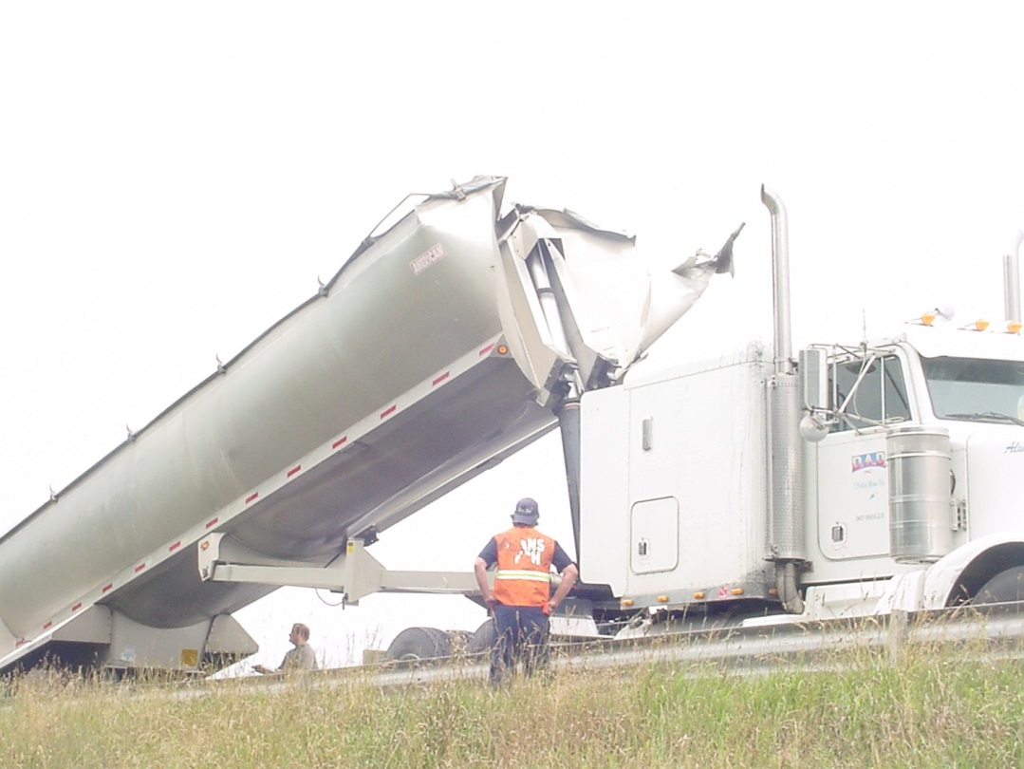
Route 721 over I-81 in Rockingham County (VA Structure No. 6555)

Slide 9
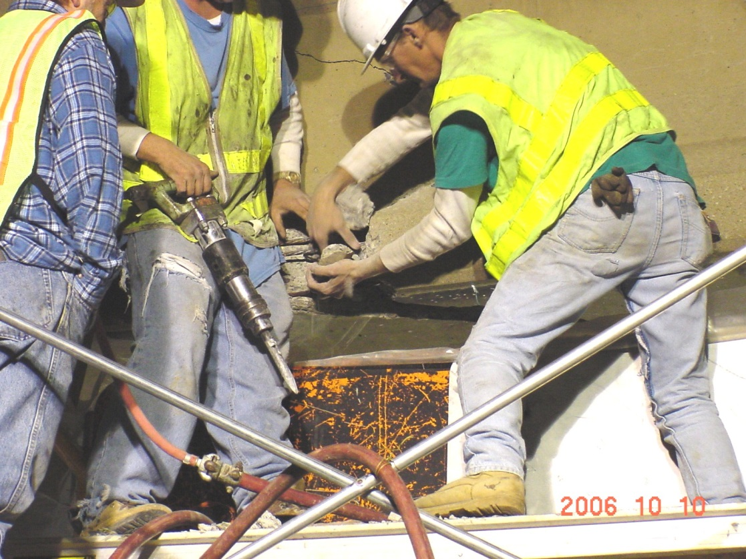
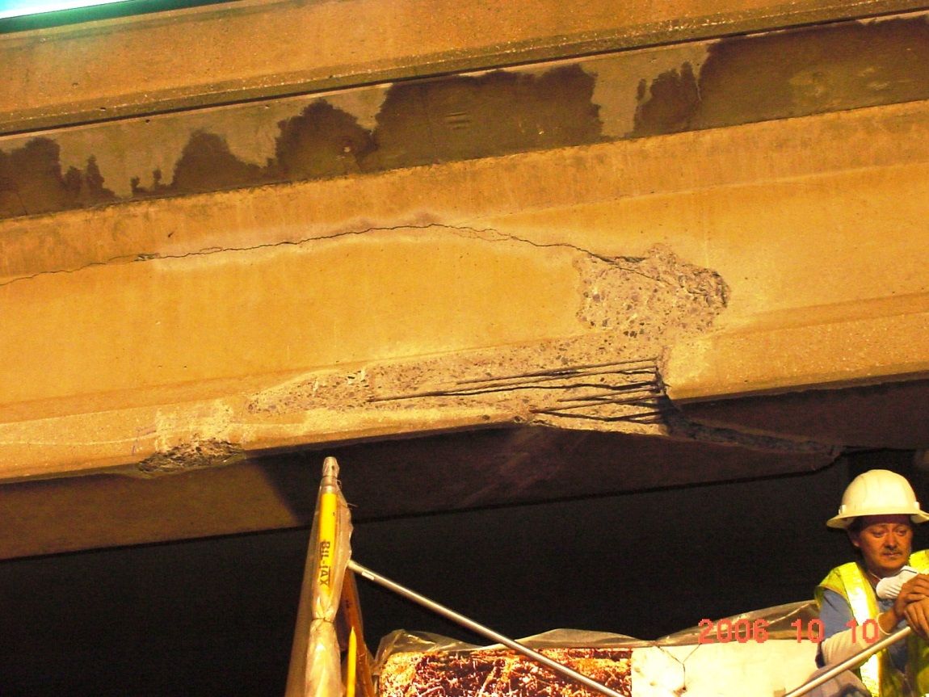
Route 721 over I-81 in Rockingham County (VA Structure No. 6555)

Slide 10
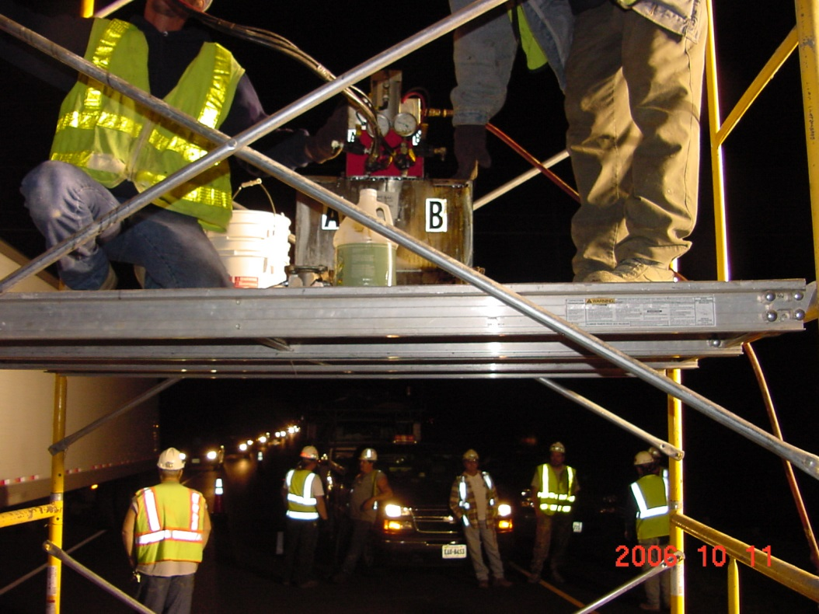
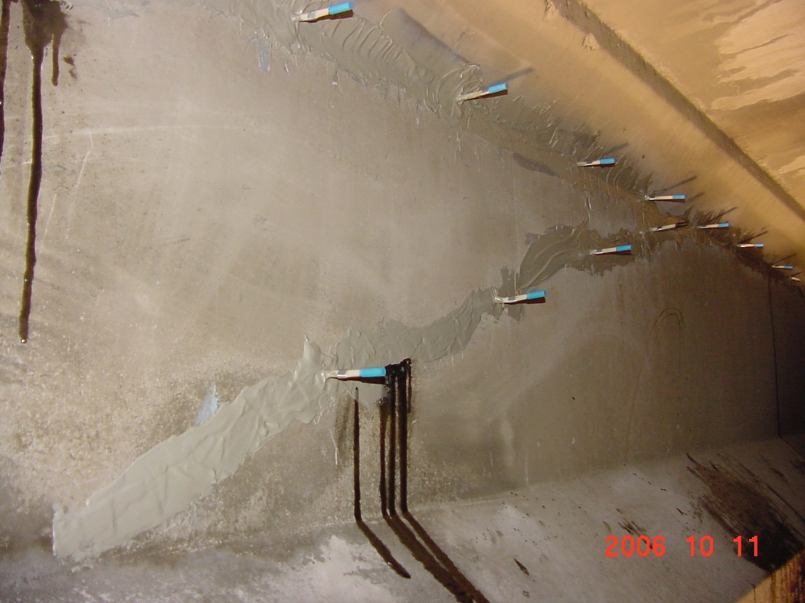
Route 721 over I-81 in Rockingham County (VA Structure No. 6555)

Slide 11
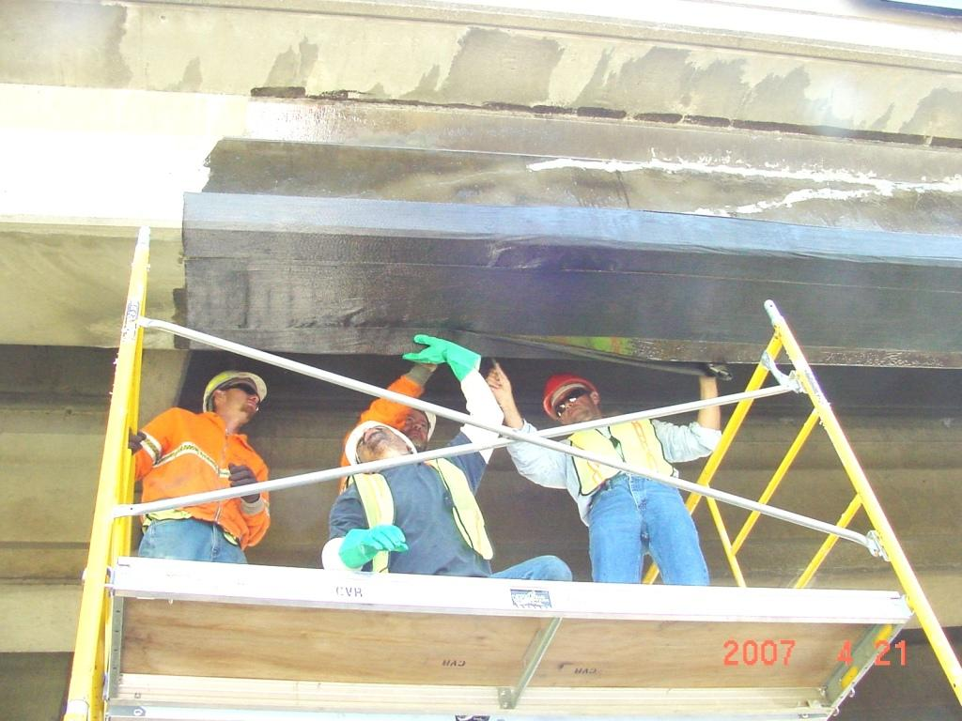
Route 721 over I-81 in Rockingham County (VA Structure No. 6555)

Slide 12
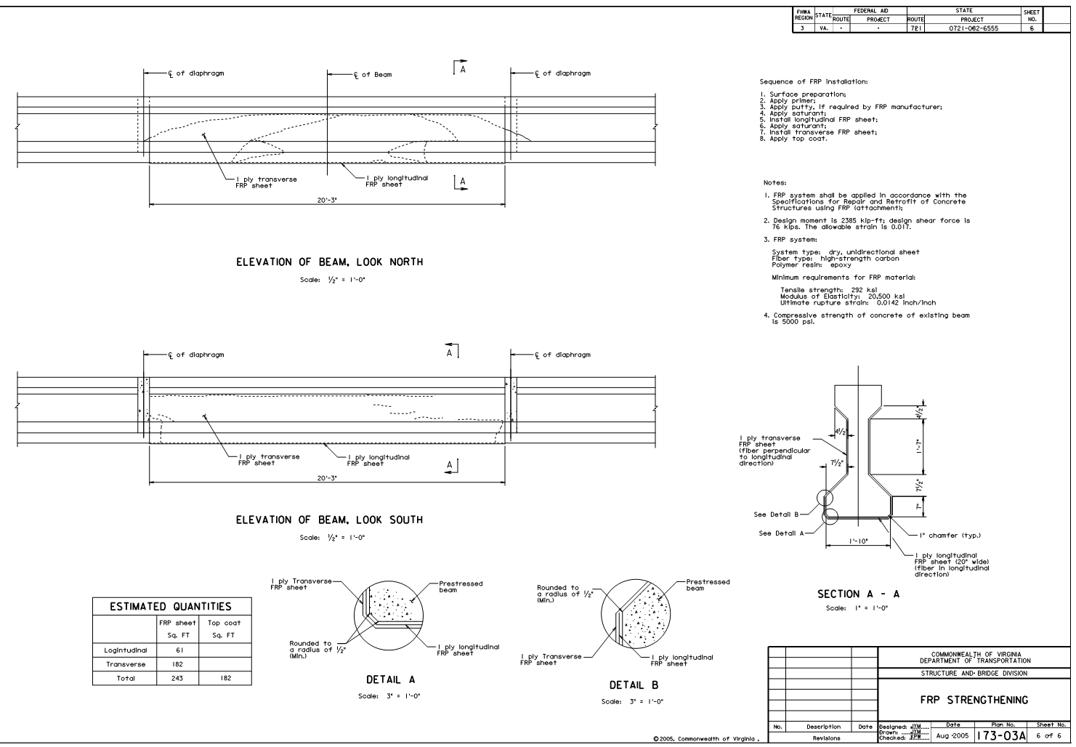
Route 721 over I-81 in Rockingham County (VA Structure No. 6555)

Slide 13
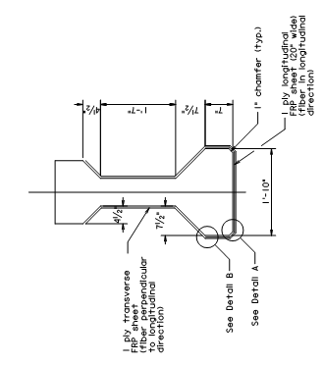
Route 721 over I-81 in Rockingham County (VA Structure No. 6555)

Slide 14
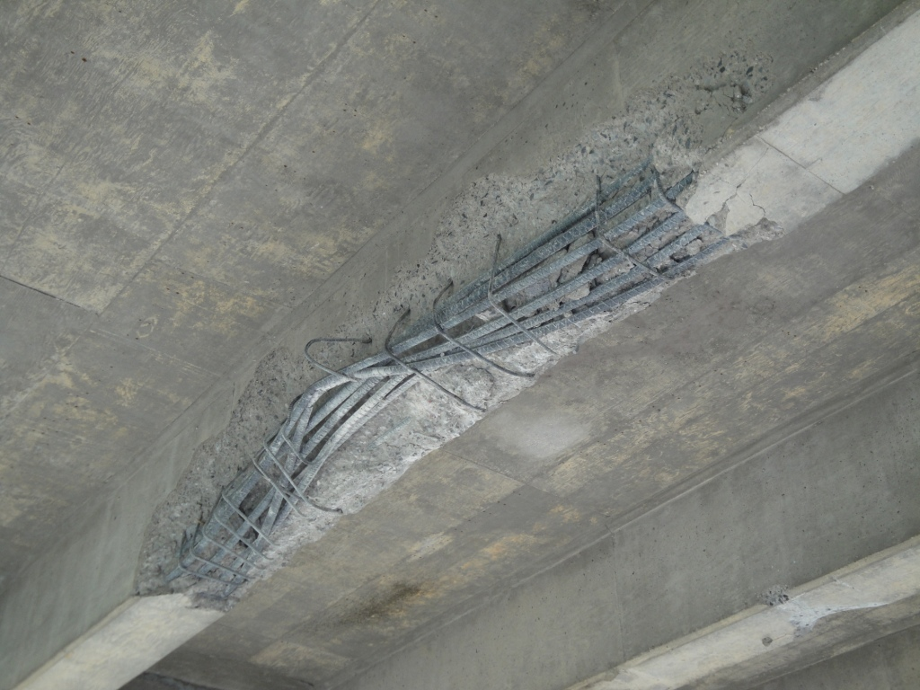
I-81 over Route 600 in Shenandoah County (VA Structure No. 2003)

Slide 15
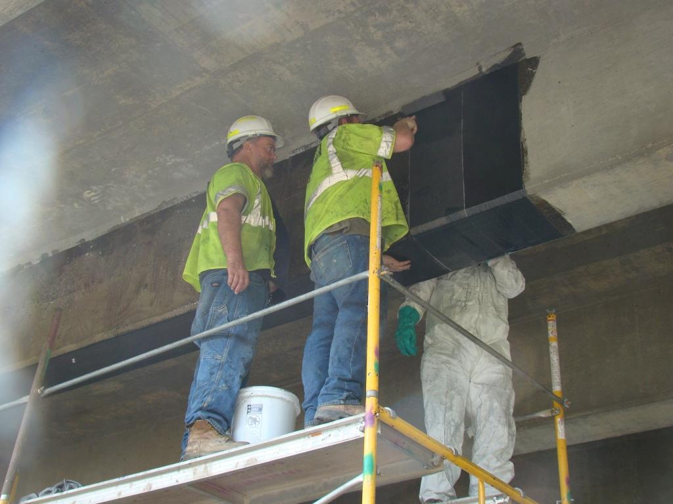
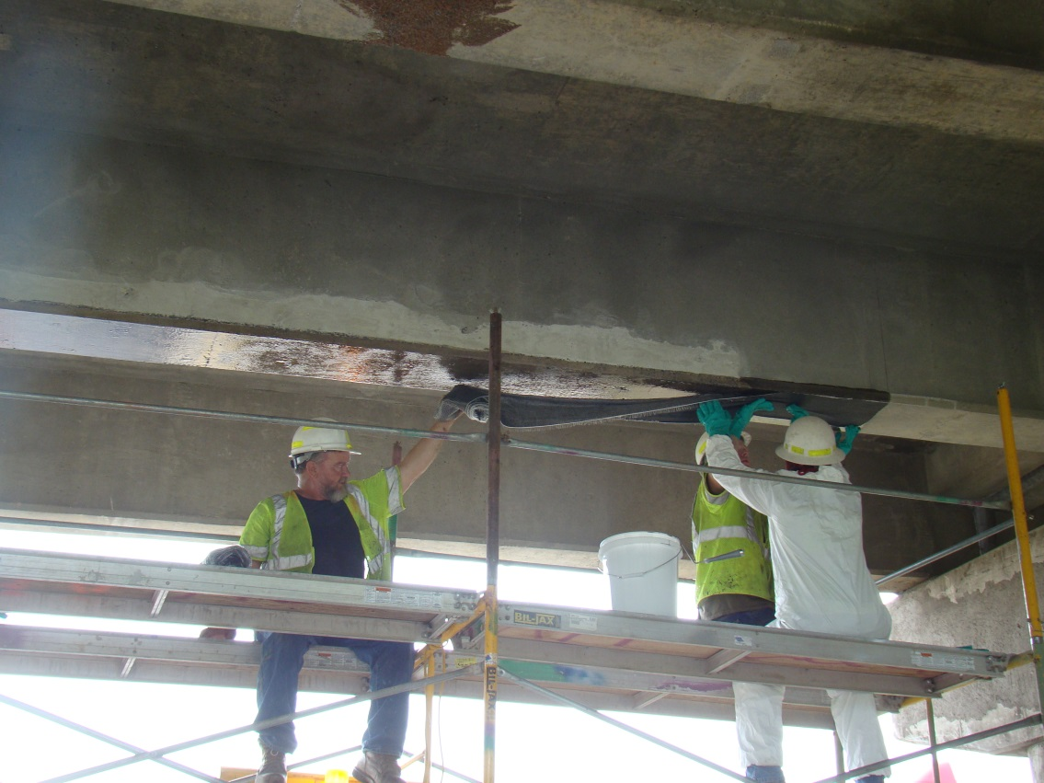
I-81 over Route 600 in Shenandoah County (VA Structure No. 2003)

Slide 16
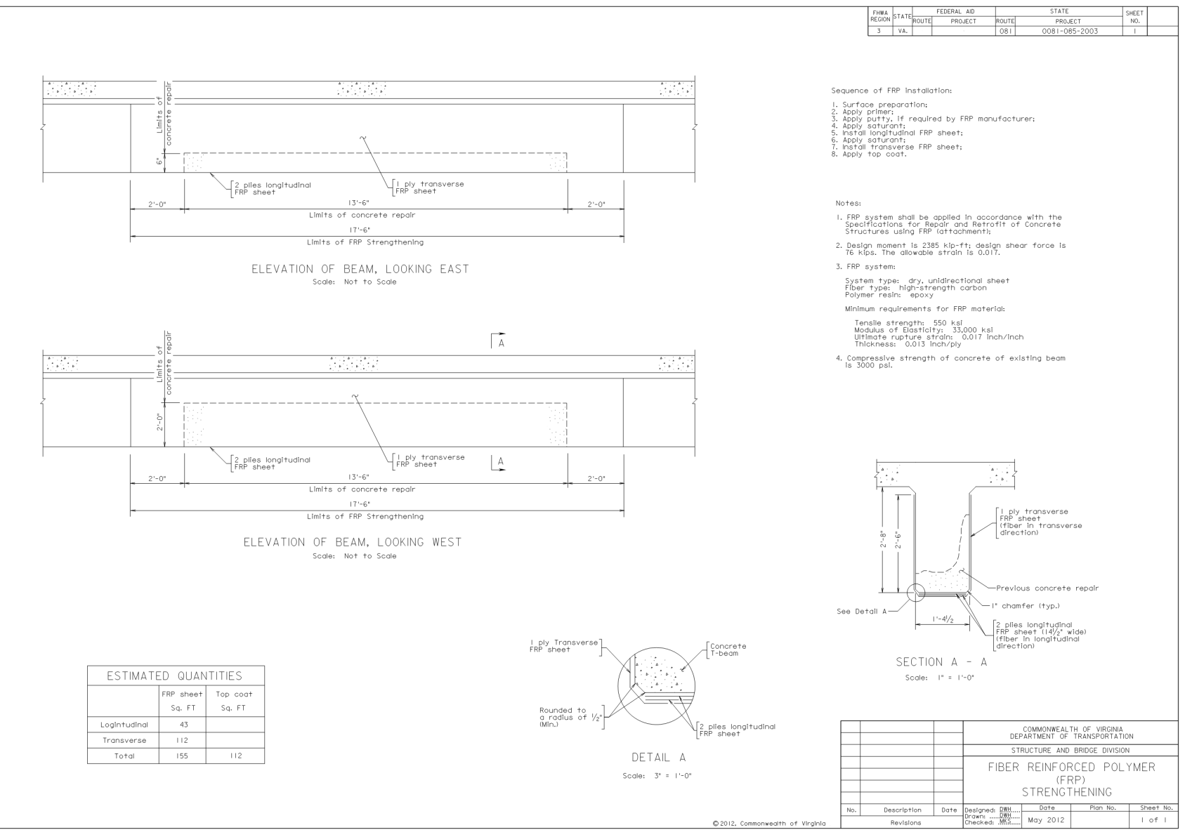
I-81 over Route 600 in Shenandoah County (VA Structure No. 2003)

Slide 17
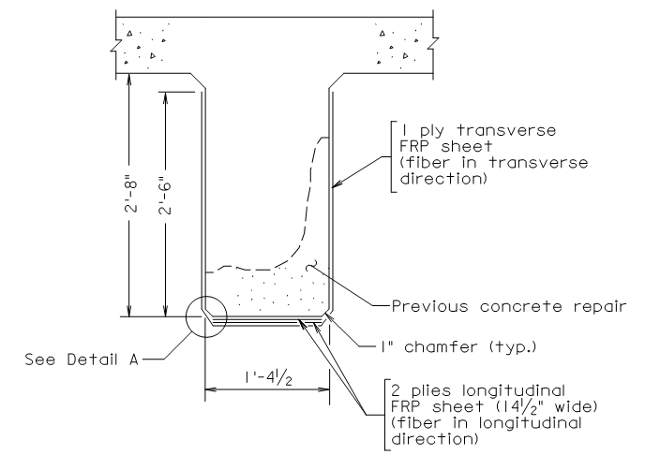
I-81 over Route 600 in Shenandoah County (VA Structure No. 2003)

Slide 18
Questions?

